Slide 1
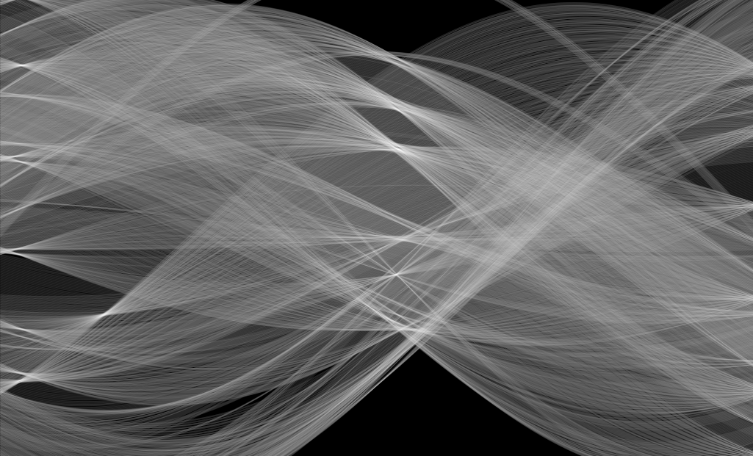
Hough Transform
Note: course materials are prepared based 1) NYU Prof. Edward Wong and CMU Prof. Ioannis Computer Vision Class

Slide 2
Overview of today’s lecture
Finding boundaries.
Line fitting.
Line parameterizations.
Hough transform.
Hough circles.
Some applications.

Slide 3
Slide credits
Most of these slides were adapted from:
Kris Kitani (15-463, Fall 2016).
Some slides were inspired or taken from:
Fredo Durand (MIT).
James Hays (Georgia Tech).

Slide 4
Finding boundaries

Slide 5
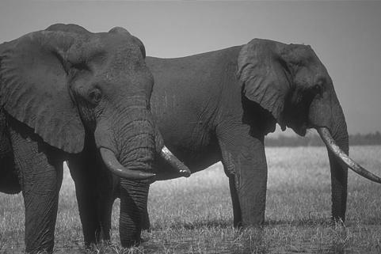
Where are the object boundaries?

Slide 6
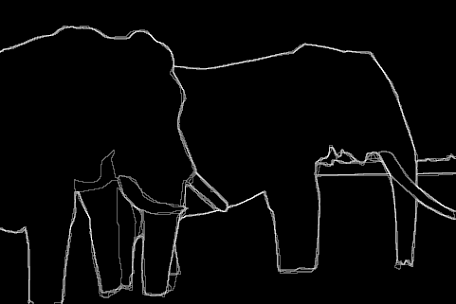
Human annotated boundaries

Slide 7
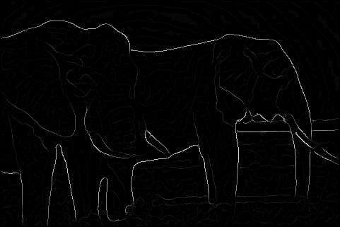
edge detection

Slide 8
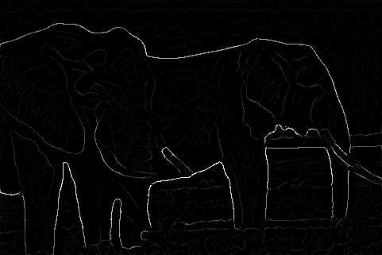
Multi-scale edge detection

Slide 9
Edge strength does not necessarily
correspond to our perception of boundaries

Slide 10
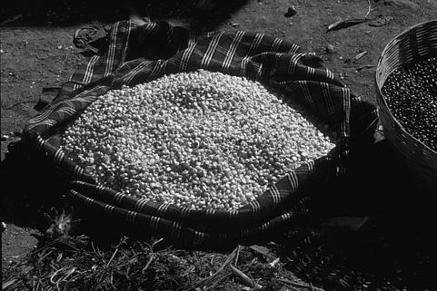
Where are the object boundaries?

Slide 11
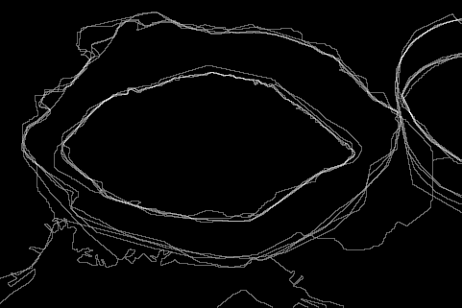
Human annotated boundaries

Slide 12
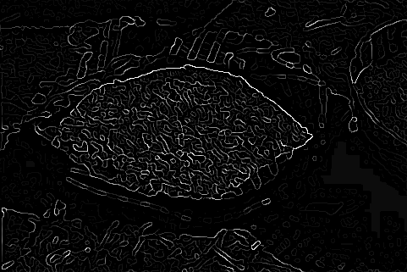
edge detection

Slide 13
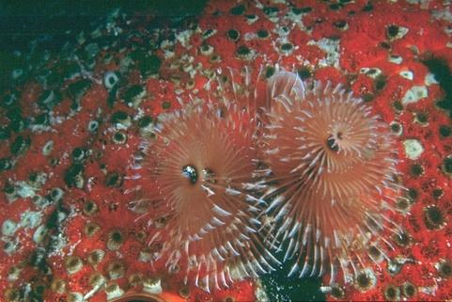
Defining boundaries are hard for us too

Slide 14
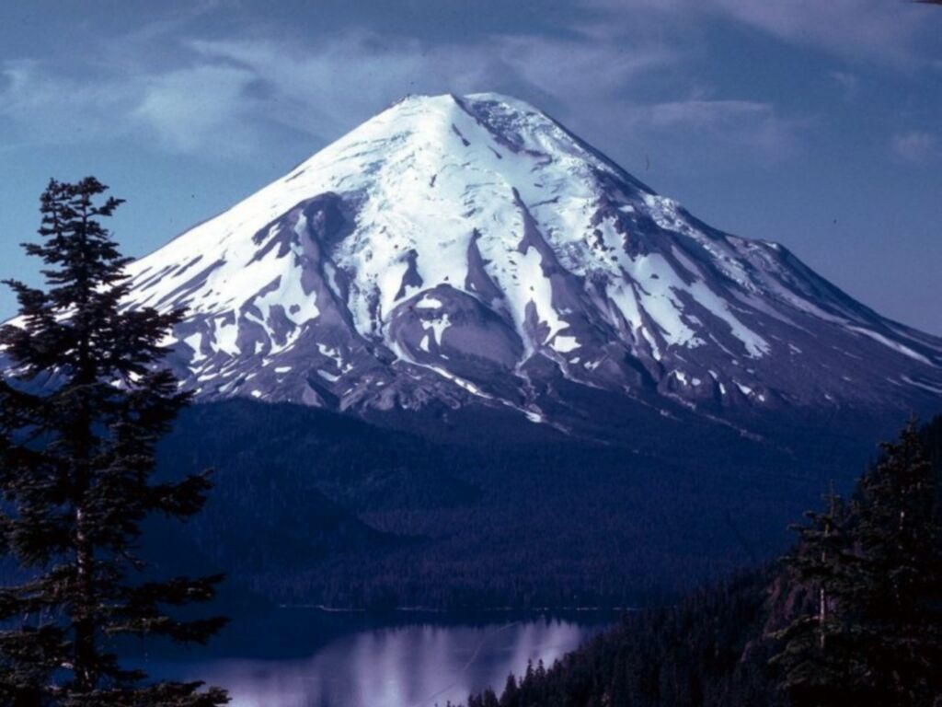
Where is the boundary of the mountain top?

Slide 15
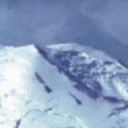
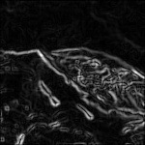
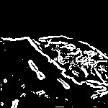
Lines are hard to find
Original image
Edge detection
Thresholding
Noisy edge image
Incomplete boundaries

Slide 16
Applications
Autonomous Vehicles
(lane line detection)
tissue engineering
(blood vessel counting)
behavioral genetics
(earthworm contours)
Autonomous Vehicles
(semantic scene segmentation)
Computational Photography
(image inpainting)

Slide 17


Slide 18
Line fitting

Slide 19
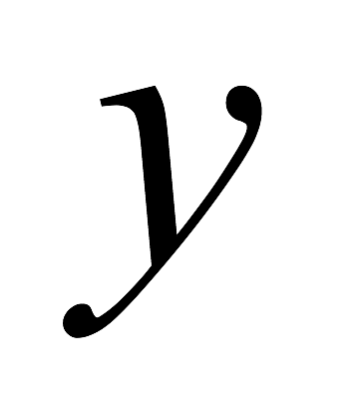
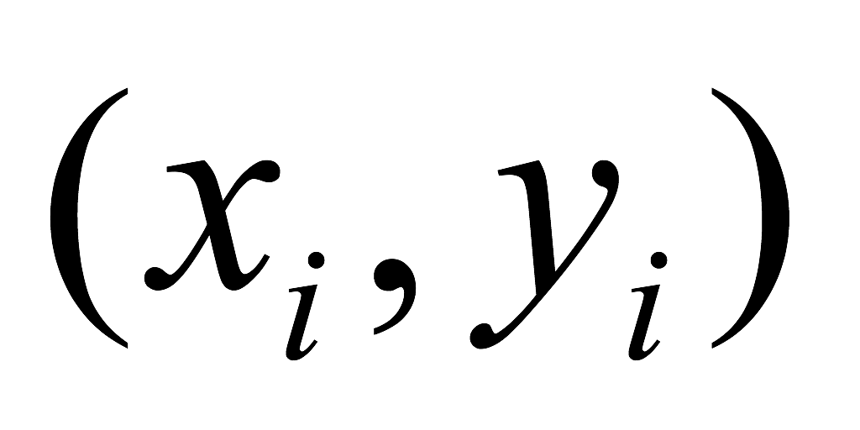
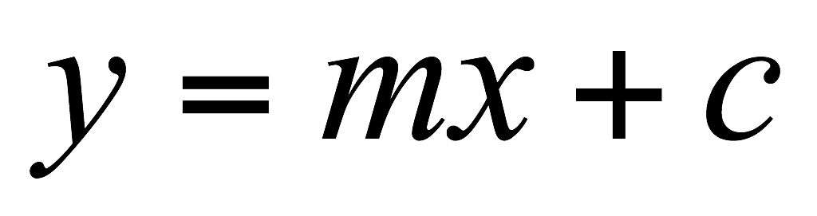
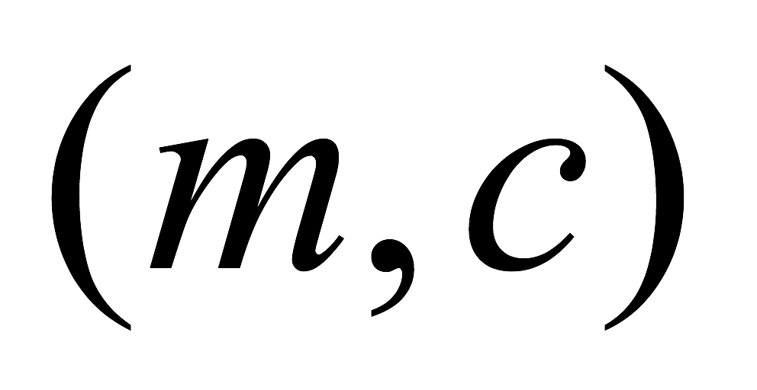
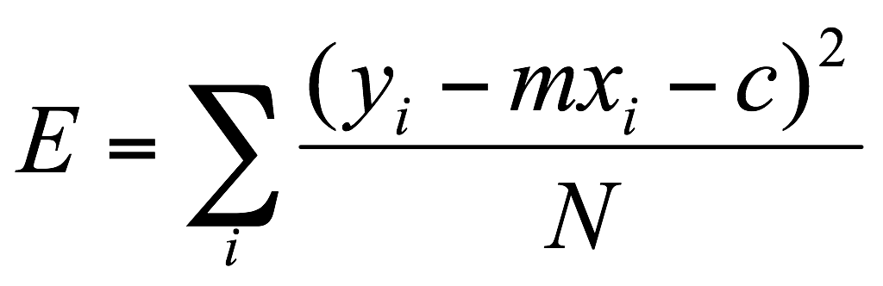
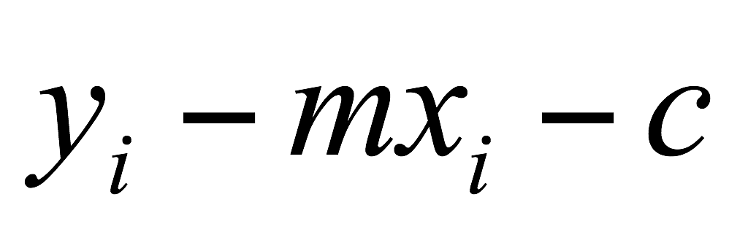
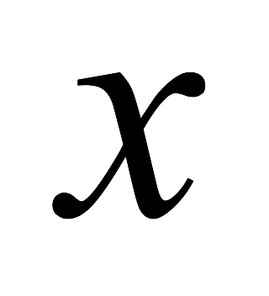
Line fitting
Given: Many pairs
Find: Parameters
Minimize: Average square distance:
Using:
Note:

Slide 20
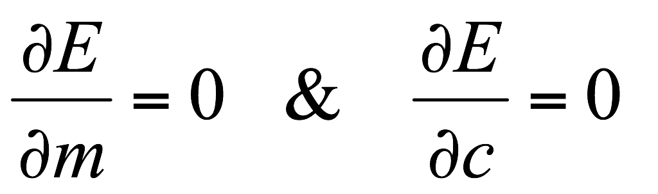
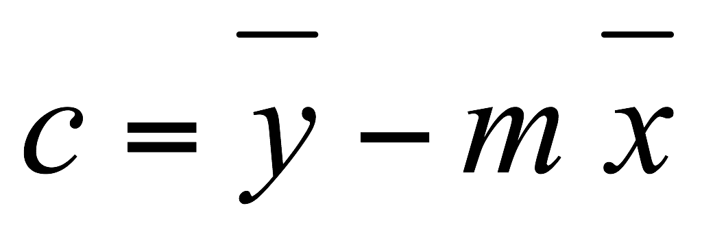
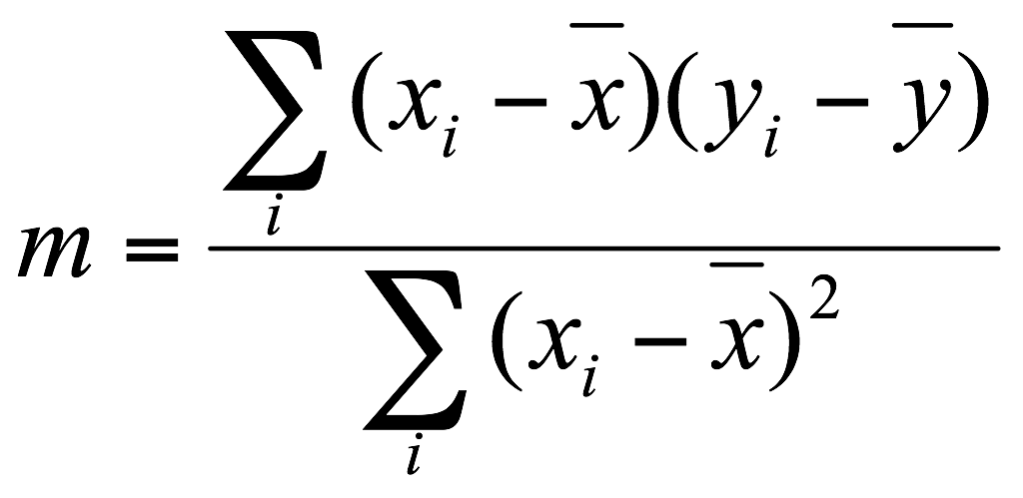
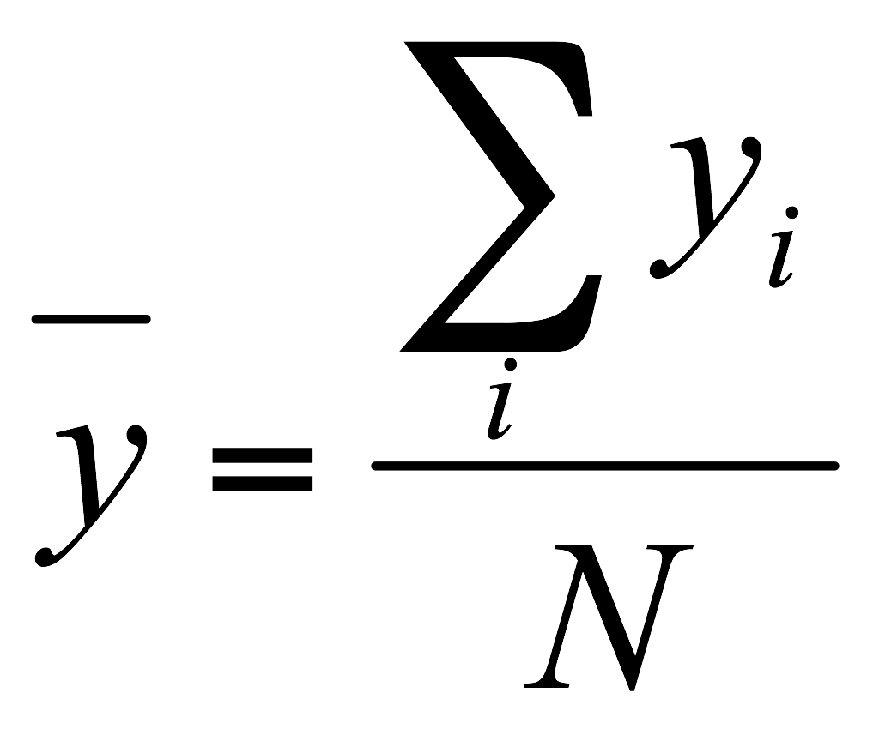
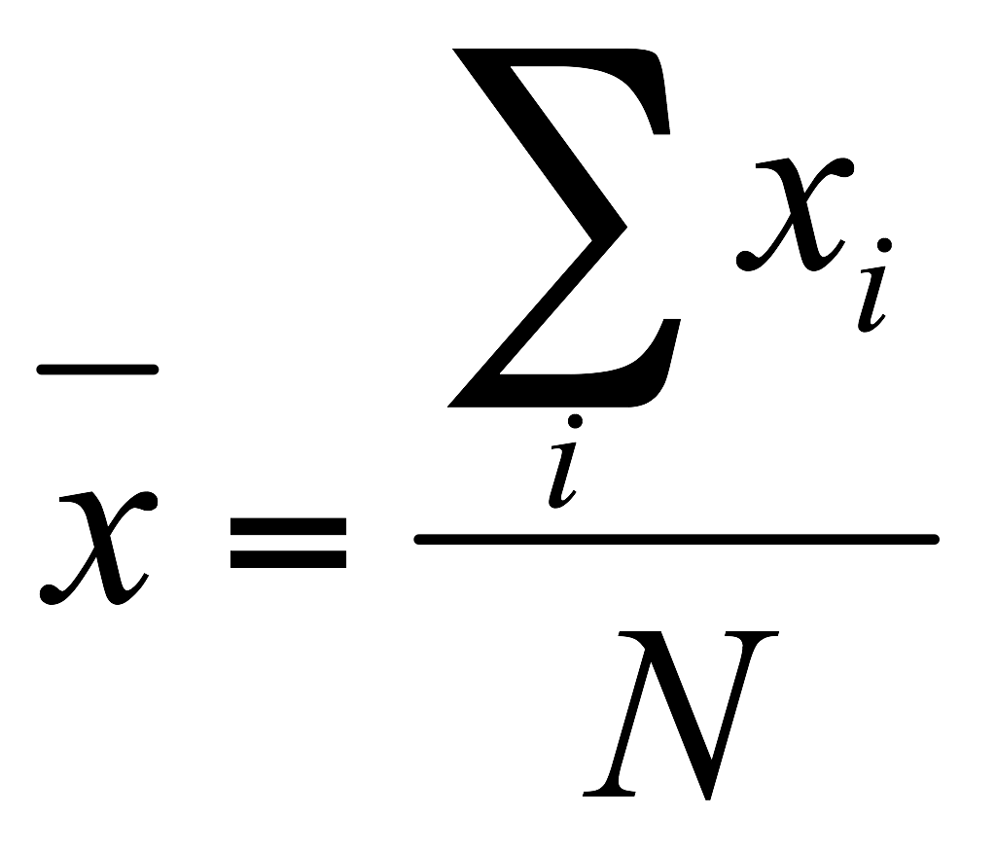
Line fitting
Given: Many pairs
Find: Parameters
Minimize: Average square distance:
Using:
Note:
What are some problems with the approach?

Slide 21
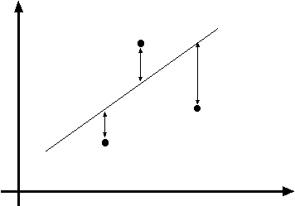
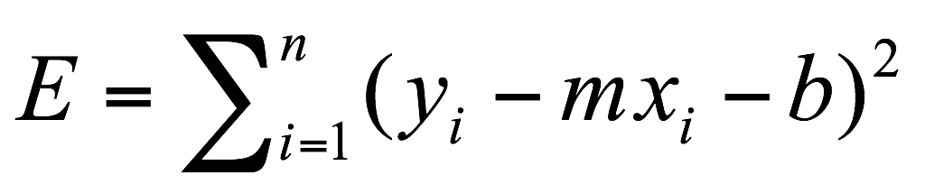
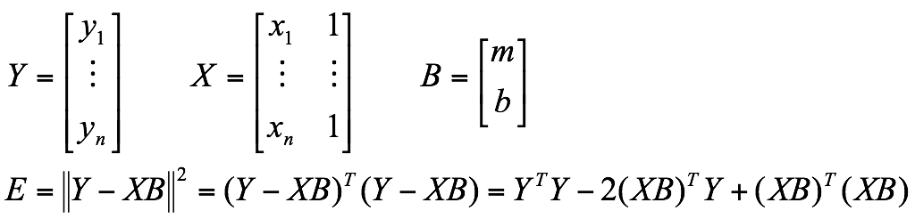
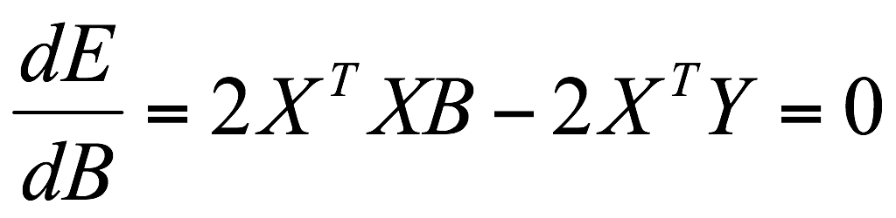
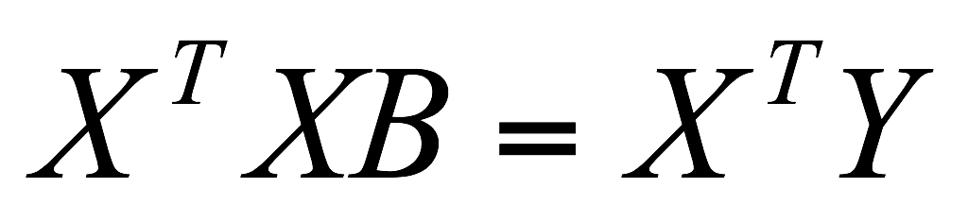
Data: (x₁, y₁), …, (x_{n}, y_{n})
Line equation: y_{i} = m x_{i} + b
(x_{i}, y_{i})
Find (m, b) to minimize
Normal equations: least squares solution to XB=Y

Slide 22
Line fitting
Given: Many pairs
Find: Parameters
Minimize: Average square distance:
Using:
Note:
How can we solve this minimization?

Slide 23
Problems with parameterizations
Where is the line that minimizes E?

Slide 24

Problems with parameterizations
Where is the line that minimizes E?
Huge E!

Slide 25

Problems with parameterizations
Where is the line that minimizes E?
Line that minimizes E!!

Slide 26
Problems with parameterizations
Where is the line that minimizes E?
Line that minimizes E!!
(Error E must be formulated carefully!)
How can we deal with this?

Slide 27
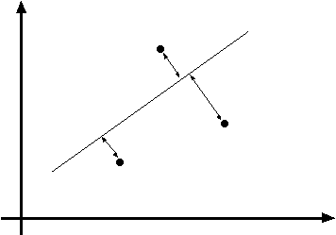
Line fitting is easily setup as a maximum likelihood problem
… but choice of model is important
What optimization are we solving here?

Slide 28
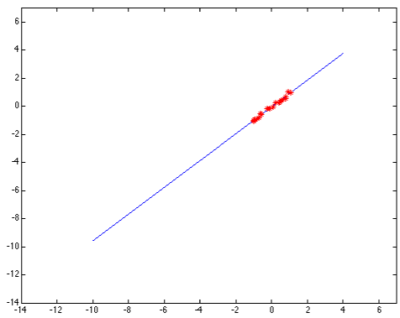
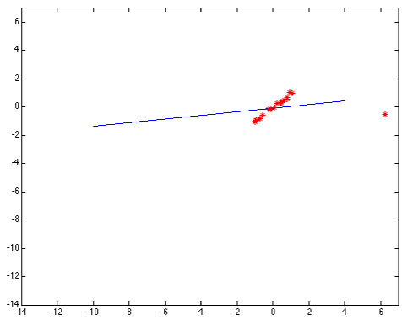
Problems with noise
Least-squares error fit
Squared error heavily penalizes outliers

Slide 29
Model fitting is difficult because…
Extraneous data: clutter or multiple models
We do not know what is part of the model?
Can we pull out models with a few parts from much larger amounts of background clutter?
Missing data: only some parts of model are present
Noise
Cost:
It is not feasible to check all combinations of features by fitting a model to each possible subset
So what can we do?

Slide 30
Line parameterizations

Slide 31
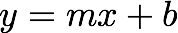


Slope intercept form
slope
y-intercept
What are m and b?

Slide 32
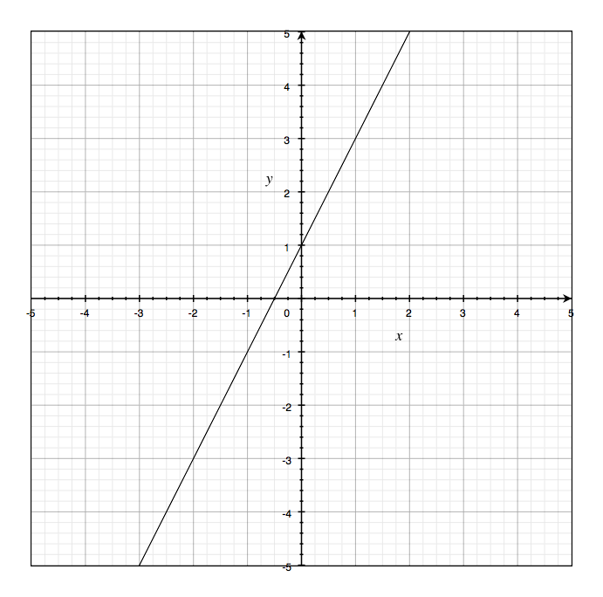
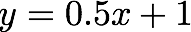
Slope intercept form
slope
y-intercept

Slide 33
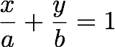
Double intercept form
x-intercept
y-intercept
What are x and y?

Slide 34
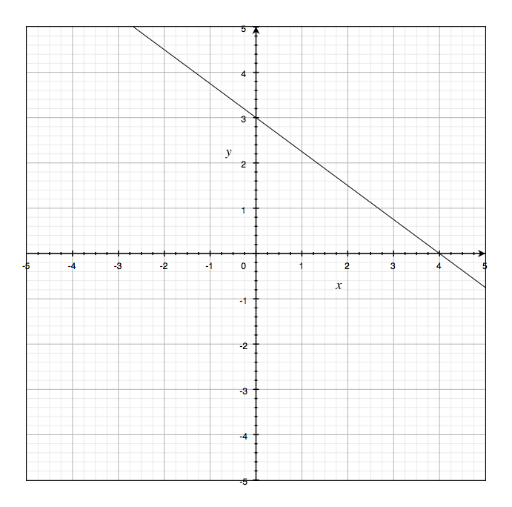
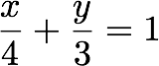
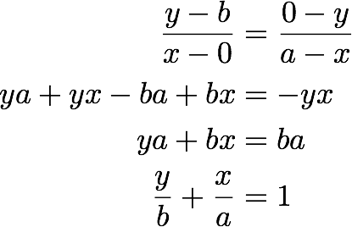

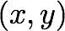
Double intercept form
x-intercept
y-intercept
Derivation:
(Similar slope)

Slide 35
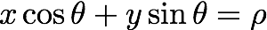
Normal Form
What are rho and theta?

Slide 36
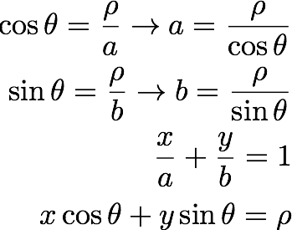
Normal Form
Derivation:
plug into:

Slide 37
Hough transform

Slide 38
Hough transform
Generic framework for detecting a parametric model
Edges don’t have to be connected
Lines can be occluded
Key idea: edges vote for the possible models

Slide 39
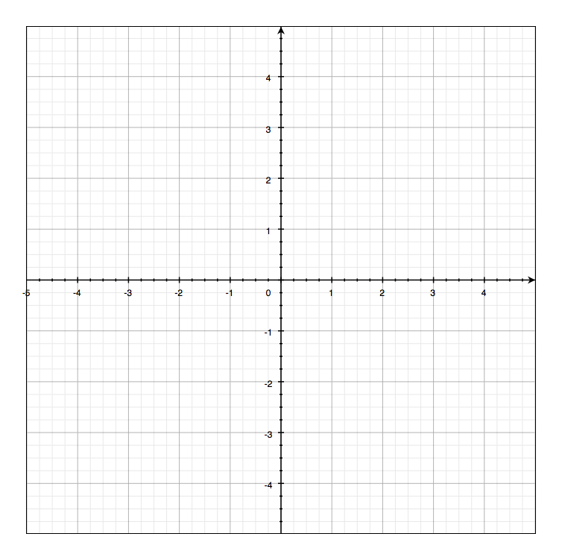
Image and parameter space
variables
parameters
Image space

Slide 40
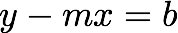
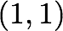
Image and parameter space
variables
variables
parameters
parameters
a line becomes a point
Image space
Parameter space

Slide 41
Image and parameter space
variables
parameters
What would a point in image space become in parameter space?
Image space

Slide 42
Image and parameter space
variables
variables
parameters
parameters
a point becomes a line
Image space
Parameter space

Slide 43
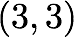
Image and parameter space
variables
variables
parameters
parameters
two points become
?
Image space
Parameter space

Slide 44
Image and parameter space
variables
variables
parameters
parameters
two points become
?
Image space
Parameter space

Slide 45
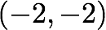
Image and parameter space
variables
variables
parameters
parameters
three points become
?
Image space
Parameter space

Slide 46
Image and parameter space
variables
variables
parameters
parameters
three points become
?
Image space
Parameter space

Slide 47
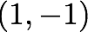
Image and parameter space
variables
variables
parameters
parameters
four points become
?
Image space
Parameter space

Slide 48
Image and parameter space
variables
variables
parameters
parameters
four points become
?
Image space
Parameter space

Slide 49
How would you find the best fitting line?
Image space
Parameter space
Is this method robust to measurement noise?
Is this method robust to outliers?

Slide 50
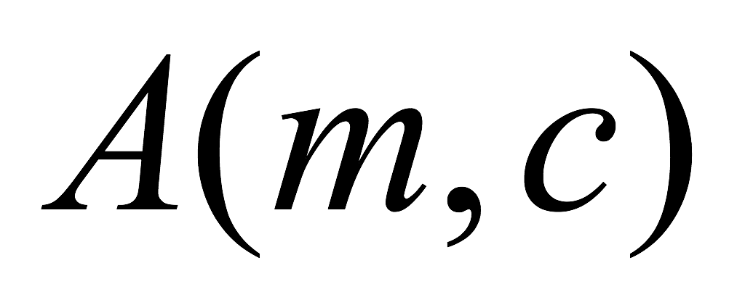



Line Detection by Hough Transform
Algorithm:
Quantize Parameter Space
Create Accumulator Array
Set
For each image edge For each element in If lies on the line: Increment
Find local maxima in
Parameter Space
 | 1 |  |  |  |  |  | 1
 |  | 1 |  |  |  | 1
 |  |  | 1 |  | 1
 |  |  |  | 2
 |  |  | 1 |  | 1
 |  | 1 |  |  |  | 1
 | 1 |  |  |  |  |  | 1

Slide 51
Problems with parameterization
How big does the accumulator need to be for the parameterization ?
 | 1 |  |  |  |  |  | 1
 |  | 1 |  |  |  | 1
 |  |  | 1 |  | 1
 |  |  |  | 2
 |  |  | 1 |  | 1
 |  | 1 |  |  |  | 1
 | 1 |  |  |  |  |  | 1

Slide 52

Problems with parameterization
How big does the accumulator need to be for the parameterization ?
 | 1 |  |  |  |  |  | 1
 |  | 1 |  |  |  | 1
 |  |  | 1 |  | 1
 |  |  |  | 2
 |  |  | 1 |  | 1
 |  | 1 |  |  |  | 1
 | 1 |  |  |  |  |  | 1
The space of m is huge!
The space of c is huge!

Slide 53




Better Parameterization
Use normal form:
Given points find
Image Space
Hough Space Sinusoid
?
(Finite Accumulator Array Size)
Hough Space

Slide 54

Image and parameter space
variables
parameters
parameters
variables
a point becomes?
Image space
Parameter space

Slide 55
Image and parameter space
variables
parameters
parameters
variables
a point becomes a wave
Image space
Parameter space

Slide 56
Image and parameter space
variables
parameters
a line
becomes?
Image space
Parameter space

Slide 57
Image and parameter space
variables
parameters
a line
becomes a point
Image space
Parameter space

Slide 58
Image and parameter space
variables
parameters
a line
becomes?
Image space
Parameter space

Slide 59
Image and parameter space
variables
parameters
a line
becomes a point
Image space
Parameter space

Slide 60
Image and parameter space
variables
parameters
a line
becomes a point
Image space
Parameter space

Slide 61
Image and parameter space
variables
parameters
a line
becomes a point
Image space
Parameter space

Slide 62
Image and parameter space
variables
parameters
a line
becomes a point
Image space
Parameter space

Slide 63
Image and parameter space
variables
parameters
a line
becomes a point
Image space
Parameter space

Slide 64

Image and parameter space
variables
parameters
Wait …why is rho negative?
a line
becomes a point
Image space
Parameter space

Slide 65

Image and parameter space
variables
parameters
same line through the point
a line
becomes a point
Image space
Parameter space

Slide 66


There are two ways to write the same line:
Positive rho version:
Negative rho version:
Recall:

Slide 67
Image and parameter space
variables
parameters
same line through the point
a line
becomes a point
Image space
Parameter space

Slide 68

Image and parameter space
variables
parameters
two points become
?
Image space
Parameter space

Slide 69

Image and parameter space
variables
parameters
three points become
?
Image space
Parameter space

Slide 70

Image and parameter space
variables
parameters
four points become
?
Image space
Parameter space

Slide 71

Implementation
Initialize accumulator H to all zeros
For each edge point (x,y) in the image For θ = 0 to 180 ρ = x cos θ + y sin θ H(θ, ρ) = H(θ, ρ) + 1 end end
Find the value(s) of (θ, ρ) where H(θ, ρ) is a local maximum
The detected line in the image is given by ρ = x cos θ + y sin θ
NOTE: Watch your coordinates. Image origin is top left!

Slide 72


Image space
Votes
Notes:
Figure 15.1, top half. Note that most points in the vote array are very dark, because they
get only one vote.

Slide 73



Basic shapes
(in parameter space)
can you guess the shape?

Slide 74
Basic shapes
(in parameter space)
line

Slide 75
Basic shapes
(in parameter space)
line
rectangle

Slide 76
Basic shapes
(in parameter space)
line
rectangle
circle

Slide 77


Basic Shapes

Slide 78

More complex image

Slide 79

In practice, measurements are noisy…
Image space
Votes
Notes:
This is 15.1 lower half

Slide 80

Too much noise …
Image space
Votes
Notes:
15.2; main point is that lots of noise can lead to large peaks in the array

Slide 81
Effects of noise level
Number of votes for a line of 20 points with increasing noise
More noise, fewer votes (in the right bin)

Slide 82
Effect of noise points
More noise, more votes (in the wrong bin)

Slide 83




Real-world example
Original
Edges
parameter space
Hough Lines

Slide 84
Hough Circles

Slide 85

Let’s assume radius known
parameters
parameters
variables
variables
What is the dimension of the parameter space?

Slide 86


parameters
parameters
variables
variables
Image space
Parameter space
What does a point in image space correspond to in parameter space?

Slide 87

parameters
parameters
variables
variables

Slide 88
parameters
parameters
variables
variables

Slide 89
parameters
parameters
variables
variables

Slide 90
parameters
parameters
variables
variables

Slide 91
What if radius is unknown?
parameters
parameters
variables
variables

Slide 92

What if radius is unknown?
parameters
parameters
variables
variables
If radius is not known: 3D Hough Space!
Use Accumulator array
Surface shape in Hough space is complicated

Slide 93



Using Gradient Information
Gradient information can save lot of computation:
Edge Location
Edge Direction
Assume radius is known:
Need to increment only one point in accumulator!

Slide 94



parameters
parameters
variables
variables

Slide 95
parameters
parameters
variables
variables

Slide 96



Slide 97

Pennie Hough detector
Quarter Hough detector

Slide 98
Pennie Hough detector
Quarter Hough detector

Slide 99
The Hough transform …
Deals with occlusion well?
Detects multiple instances?
Robust to noise?
Good computational complexity?
Easy to set parameters?

Slide 100
Can you use Hough Transforms for other objects,
beyond lines and circles?
Do you have to use edge detectors to vote in Hough Space?

Slide 101
Application of
Hough transforms

Slide 102



Detecting shape features
F. Jurie and C. Schmid, Scale-invariant shape features for recognition of object categories, CVPR 2004

Slide 103

Original images
Laplacian circles
Hough-like circles
Which feature detector is more consistent?

Slide 104

Robustness to scale and clutter

Slide 105
References
Basic reading:
Szeliski textbook, Sections 4.2, 4.3.

